Slide 1

Introduction to Machine Learning in R
Dr Giorgia Mori
Dr Henry Lydecker
Sydney Informatic Hub

Slide 2
Sydney Informatics Hub
SIH is a Core Research Facility of the University of Sydney enabling excellence in computational and data-driven research through advanced digital infrastructure, expert data consultancy and analytics training
”
https://sydney.edu.au/sydney-informatics-hub
Notes:
Hi, I’m Xinwei, and I’m going to talk about our team at the Sydney Informatics Hub. We are a core research facility supporting computational and data-driven research across every discipline through a range of services and activities we offer, which I will introduce in the up coming slides.
and we do this by helping to provide access to research infrastructure such as high-performance computing and storage, supporting researchers by providing data analysis expertise, providing training in advanced data analysis and computing, and building data communities with events such as hacky hours, seminars, hackathons and outreach events like this one
Other CRFs:
Research and prototype foundry
Sydney Analytical
Sydney Cytometry
Sydney Imaging
Sydney Manufacturing Hub
Sydney Mass Spectrometry
Sydney Microscopy and Microanalysis

Slide 3
Sydney Informatics Hub Empowering researchers with modern data & computational methods
Consultation
Grant application support
Data Science, ML, modelling & analytics
Hacky Hour
Training
Research compute platforms
Research Computing
High performance computing
Bioinformatics & genomics
Modelling & visualisation
Computing training
Statistical Consulting
1-on-1 consultancy for HDR-level and above.
Experiment and survey design.
Statistical model development and testing
Statistics training
Data Science & SWE
Consulting and project collaboration providing analysis & software development for data-driven research.
Notes:
We can provide support for researchers through the 3 main areas shown here:
First, we providing researchers access to HPC when needed
Secondly, we provide various types of Consultations
It can be one on one, it can be group consultations, it can in a short 1 hours session, or we can also provide long term support for projects
Finally, we also provide data science and software engineering support to researchers who need help with their data driven projects
We also provide addition training in data analysis and computing, and we also aim to build data communities with events such as hacky hours, hackathons and outreach events like this one
working for publication, or working for grant applications

Slide 4
Code of Conduct
We expect all attendees of our training to follow the University of Sydney’s Staff and Student Codes of Conduct, including the Bullying, harassment and discrimination prevention policy.
In order to foster a positive and professional learning environment we encourage the following kinds of behaviours at all our events and platforms:
Use welcoming and inclusive language
Be respectful of different viewpoints and experiences
Gracefully accept constructive criticism
Focus on what is best for the community
Show courtesy and respect towards other community members
Our full CoC, with incident reporting guidelines, is available at https://pages.github.sydney.edu.au/informatics/sih_codeofconduct/
Notes:
In line with the University of Sydney Codes of Conduct for staff and students,

Slide 5
(Examples of) Unacceptable behaviour
Sustained disruption of talks, events or communications
Written/verbal comments which have the effect of excluding people on the basis of membership of any specific group
Causing someone to fear for their safety, such as through stalking, following, or intimidation
Violent threats or language directed against another person
The display of sexual or violent images
Unwelcome sexual attention; non-consensual or unwelcome physical contact
Insults or put downs; excessive swearing
Sexist, racist, homophobic, transphobic, ableist, or exclusionary jokes
Incitement to violence, suicide, or self-harm
Continuing to initiate interaction (including photography or recording) with someone after being asked to stop
Publication of private communication without consent
Notes:
In line with the University of Sydney Codes of Conduct for staff and students, we ask you not to engage in any of these examples of unacceptable behavior.
We’d especially like to point out the first one: “disruption of talks, communications”, since this is something we’ve had issues with in the past. Some of us (and I know I can be guilty of this) have louder voices… So while we’d definitely encourage you to speak out, we have found that if we have students who are more comfortable speaking at full volume with a helper we may ask them to switch their seat so the conversation doesn’t impede the learning of students around them. So please don’t be offended if we ask you to move – we’re really trying to make sure everyone is able to learn effectively. ..

Slide 6
Plan for the workshop
Your data budget;
Feature engineering;
What makes a model;
Evaluating models;
Tuning hyperparameters;
Wrapping up!
Time | Day 1 | Day 2
9:00 am – 10:30 am | Session 1
10:30 am – 11:00 am | Morning break | Break
11:00 am - 12:30 pm | Session 2
12:30 pm – 1:30 pm | Lunch | Lunch
1:30 - 3:00 pm | Session 3
3:00 pm - 3:30 pm | Afternoon break
3:30 pm – 5:00 pm | Session 4

Slide 7

Asking for Help
I’m not stuck
but I need help with my computer
I’m stuck
I need help understanding something
(which likely means others do too)

Slide 8

How are statistics and Machine Learning related?

Slide 9


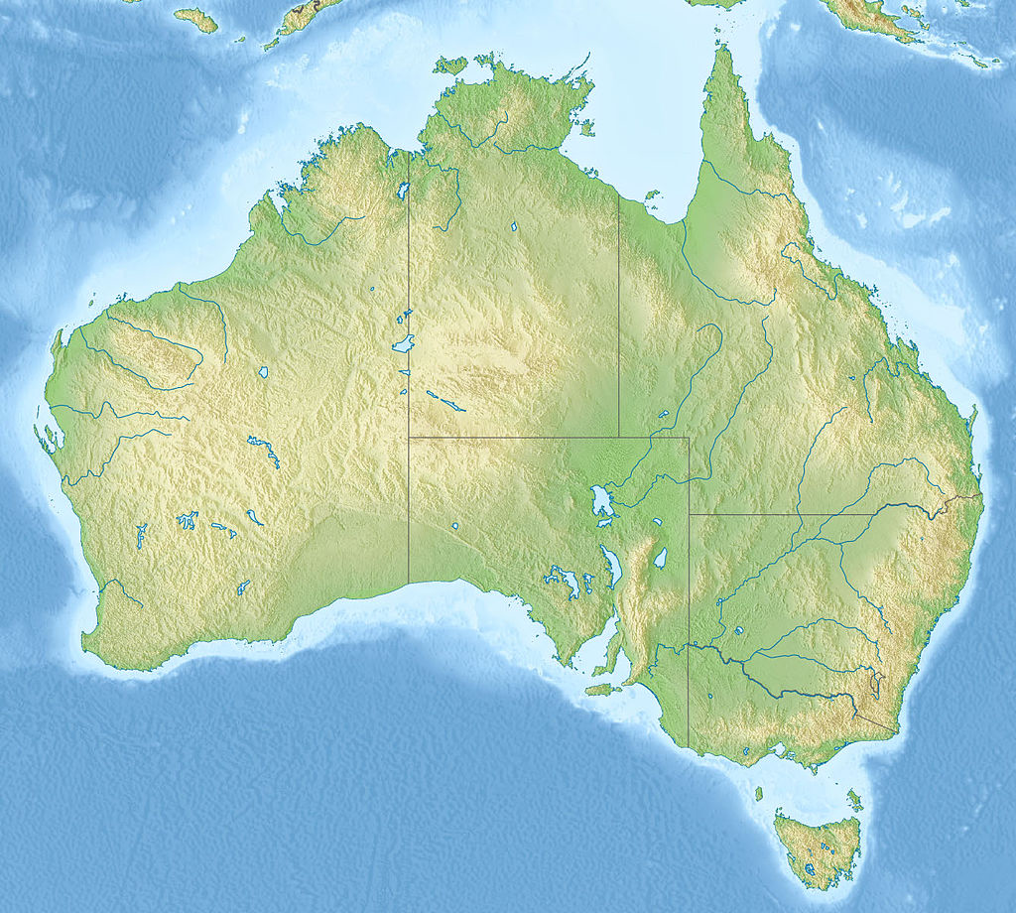

Statistics: inferring from samples

Slide 10


Machine Learning: making generalizable predictors
5 beds
4 baths
Water views
Mosman
Featured on fancy architecture website

Slide 11


Skill comes from learning and practice

Slide 12
Statistical modeling is an extension of hypothesis testing
Explains?
Hypothesis
Reality
Matches?
Model
Data
Reject or not

Slide 13
The goal of Machine Learning is to generate accurate predictions
Old Data
Model
TRAIN
New Data
Trained Model
Improve?
Predictions

Slide 14
What is tidymodels?

Slide 15
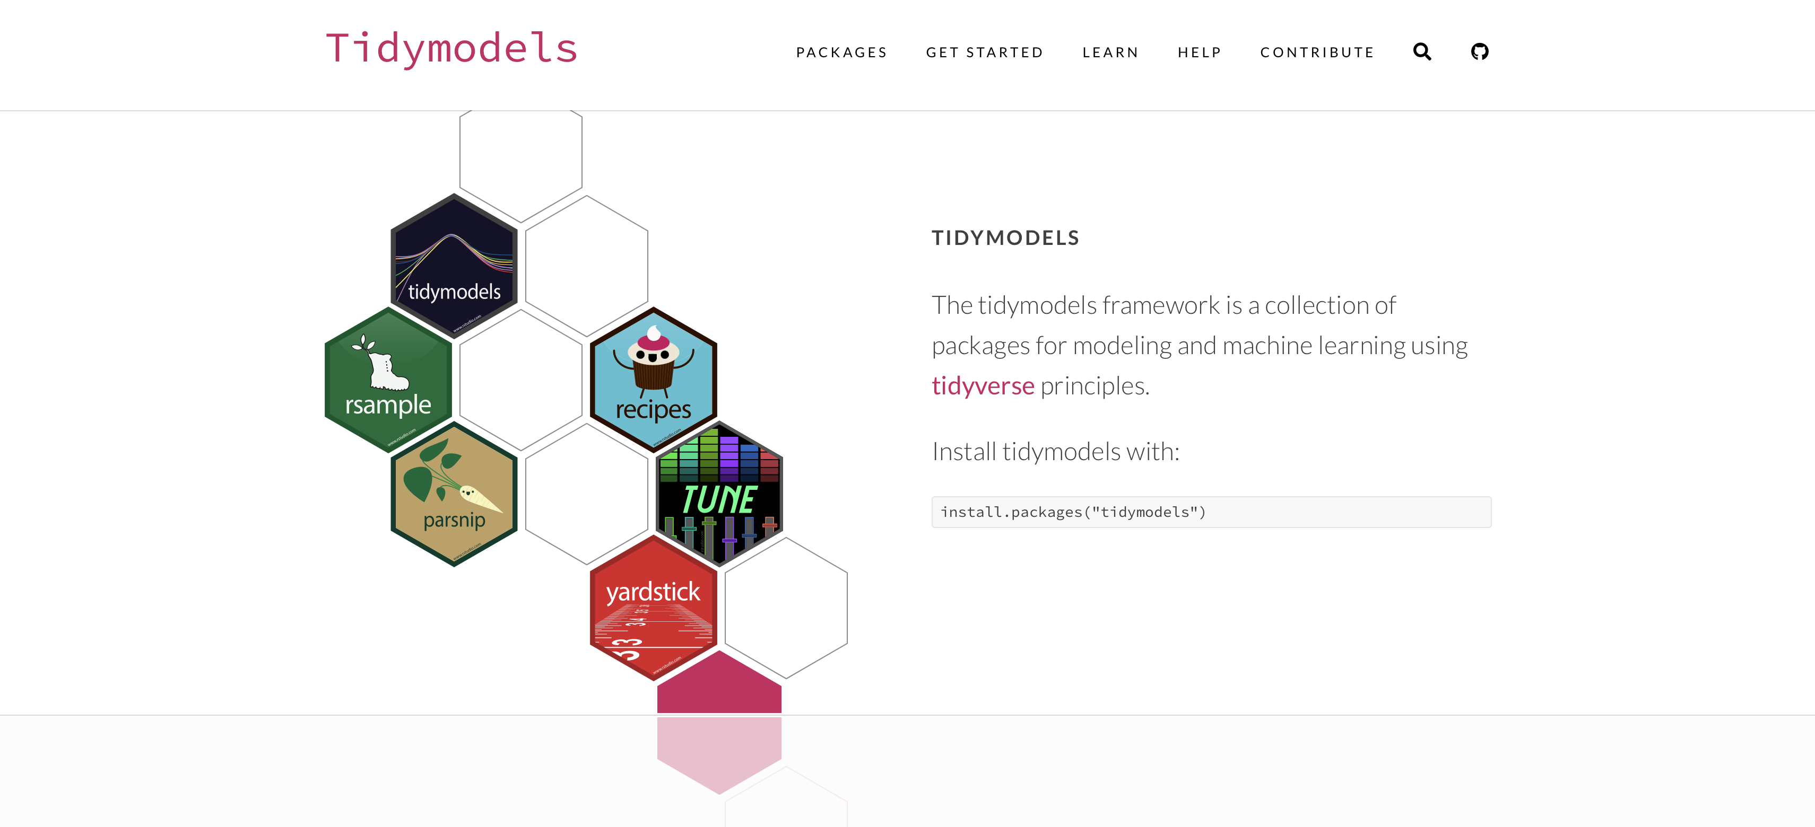

Slide 16
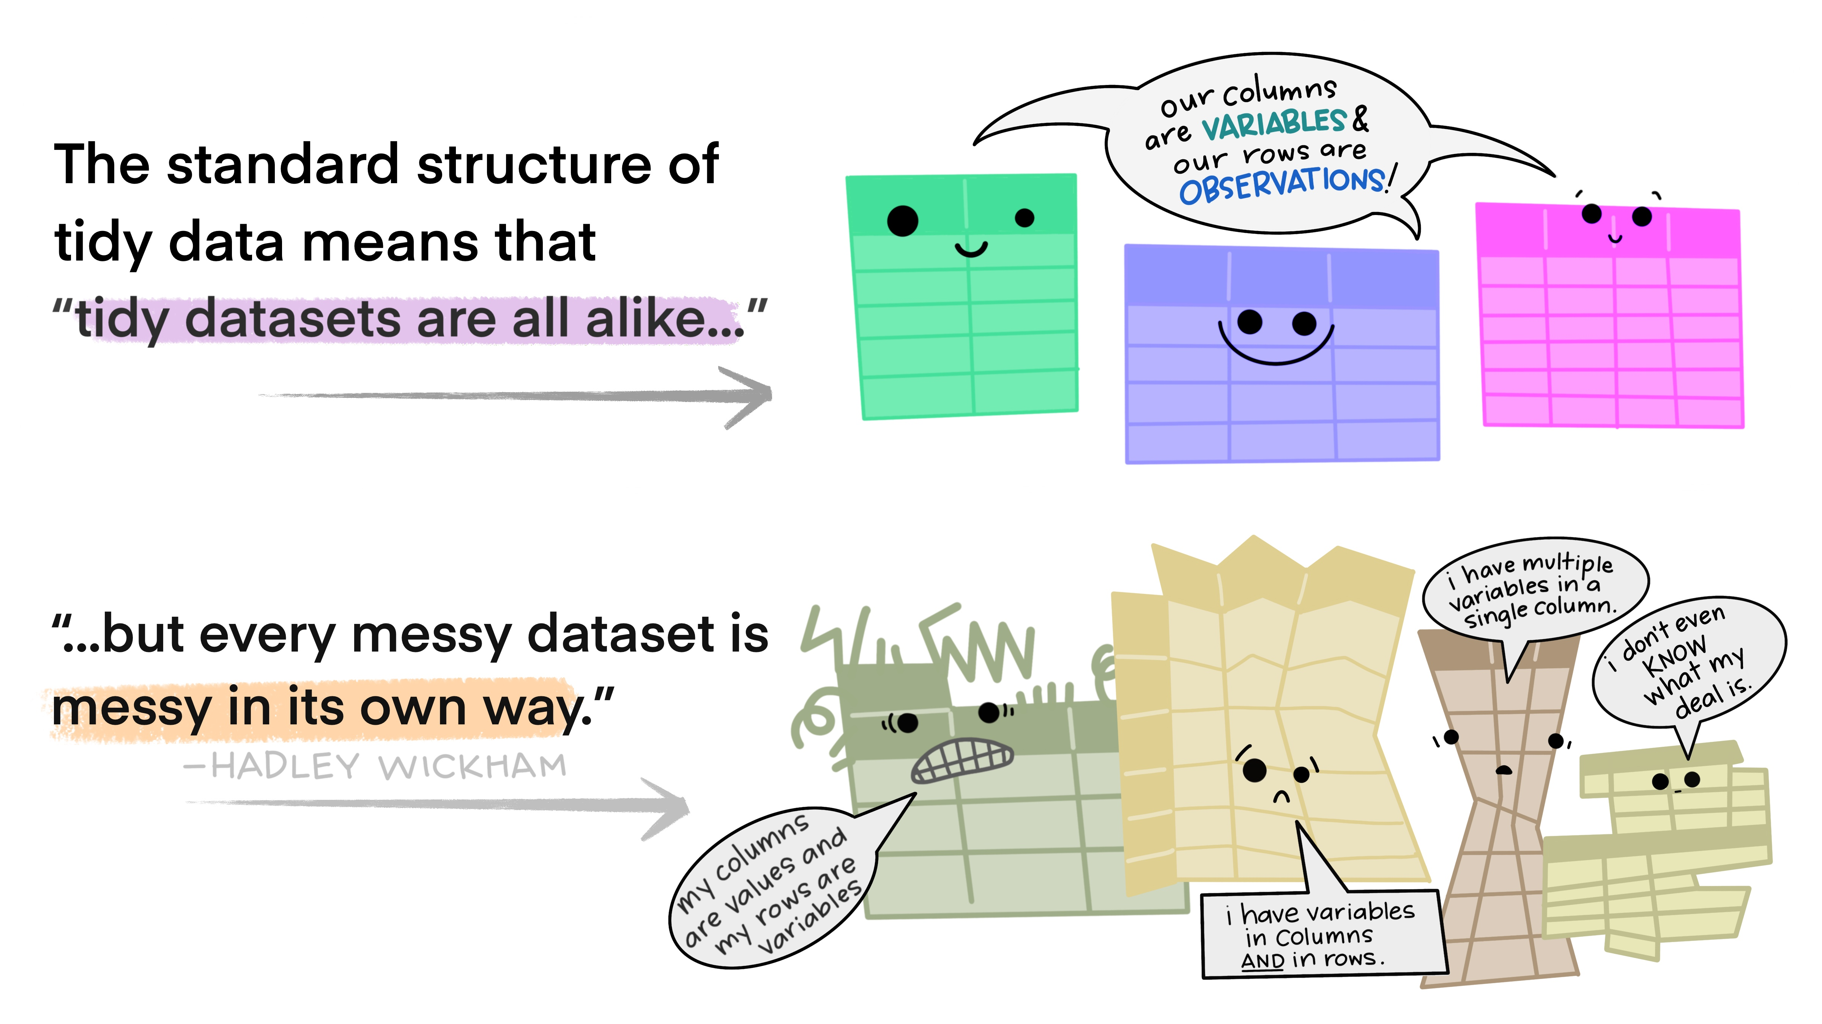
Why using Tidymodels
https://allisonhorst.com/other-r-fun

Slide 17
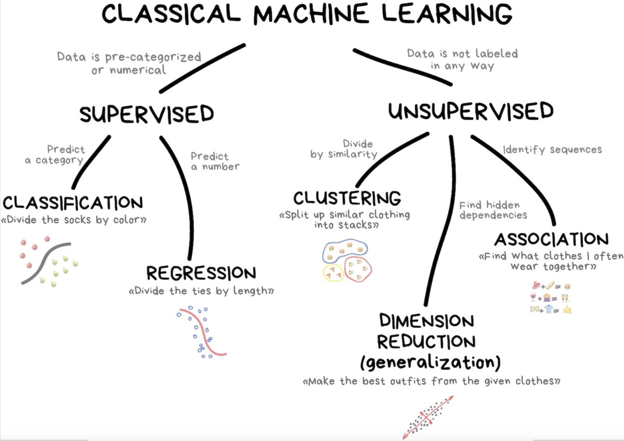
https://vas3k.com/blog/machine_learning/

Slide 18
Your turn!
Form teams within your table;
Share your backgrounds with R, data, and Machine Learning;
Choose a team name.

Slide 19
Dataset - AmesHousing
Descriptions of 2,930 houses sold in Ames, IA from 2006 to 2010, collected by the Ames Assessor’s Office.
#install.packages(“AmesHousing”)
library(AmesHousing)
ameshousing <- AmesHousing::make_ames()

Slide 20
Exploratory Data Analysis (EDA)
Notes:
Follow website, introduce concept of outcome and features/predictors

Slide 21
Tidymodels
Notes:
Follow website and slides

Slide 22
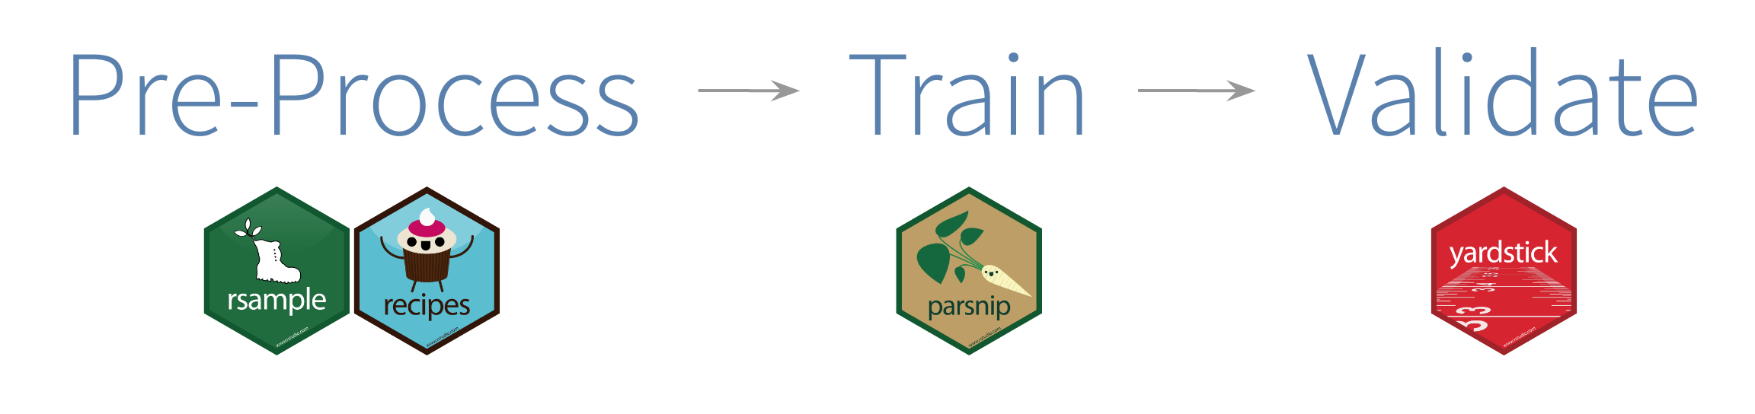

Slide 23

Your data budget - Data splitting
For machine learning, we typically split data into training and test sets:
The training set is used to estimate model parameters.
The test set is used to find an independent assessment of model performance.
Some commonly used cut-offs include:
60% training / 40% testing
70% training / 30% testing
80% training / 20% testing

Slide 24
Your data budget - Data spending
Spending too much data in training prevents us from computing a good assessment of predictive performance;
Spending too much data in testing prevents us from computing a good estimate of model parameters.

Slide 25
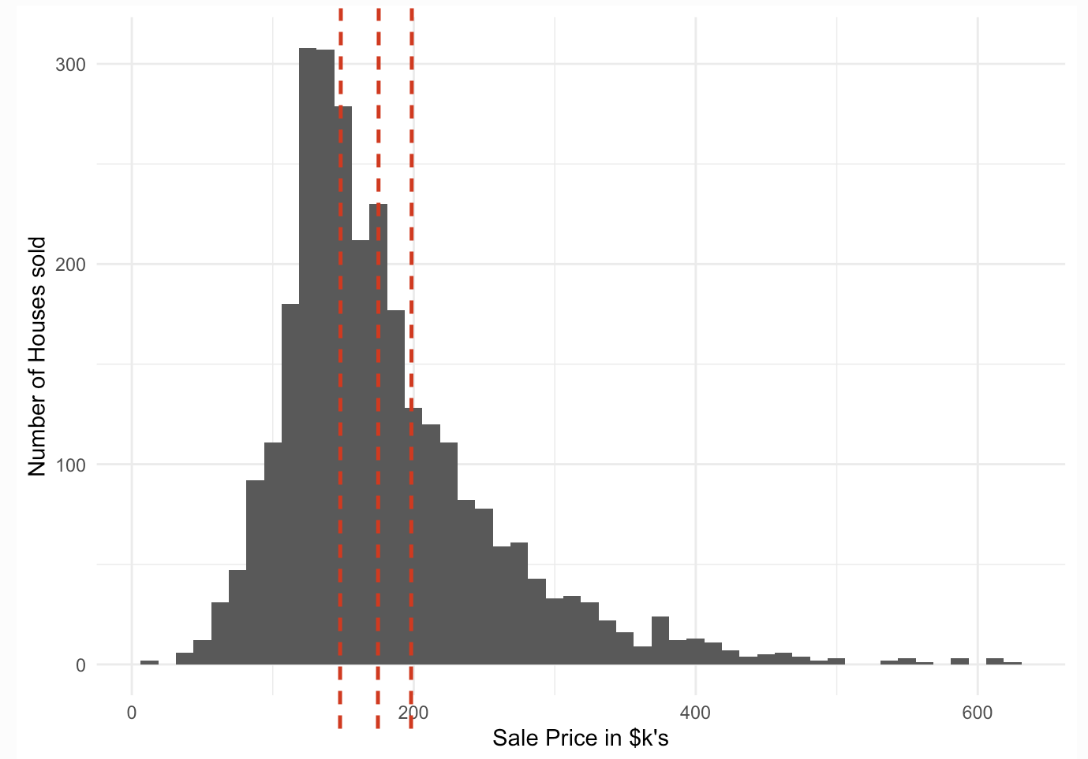
set.seed(42)
ames_split <- ames_data %>%
initial_split(prop = 0.8,
strata = Sale_Price)
ames_train <- training(ames_split)
ames_test <- testing(ames_split)
Notes:
The code here takes an input data set and puts 80% of it into a training dataset and 20% of it into a testing dataset; it chooses the individual cases so that both sets are balanced in selling price.
Stratified sampling would split within each quartile. It ensures that the proportion of the outcome/target variable is maintained in each set.

Slide 26
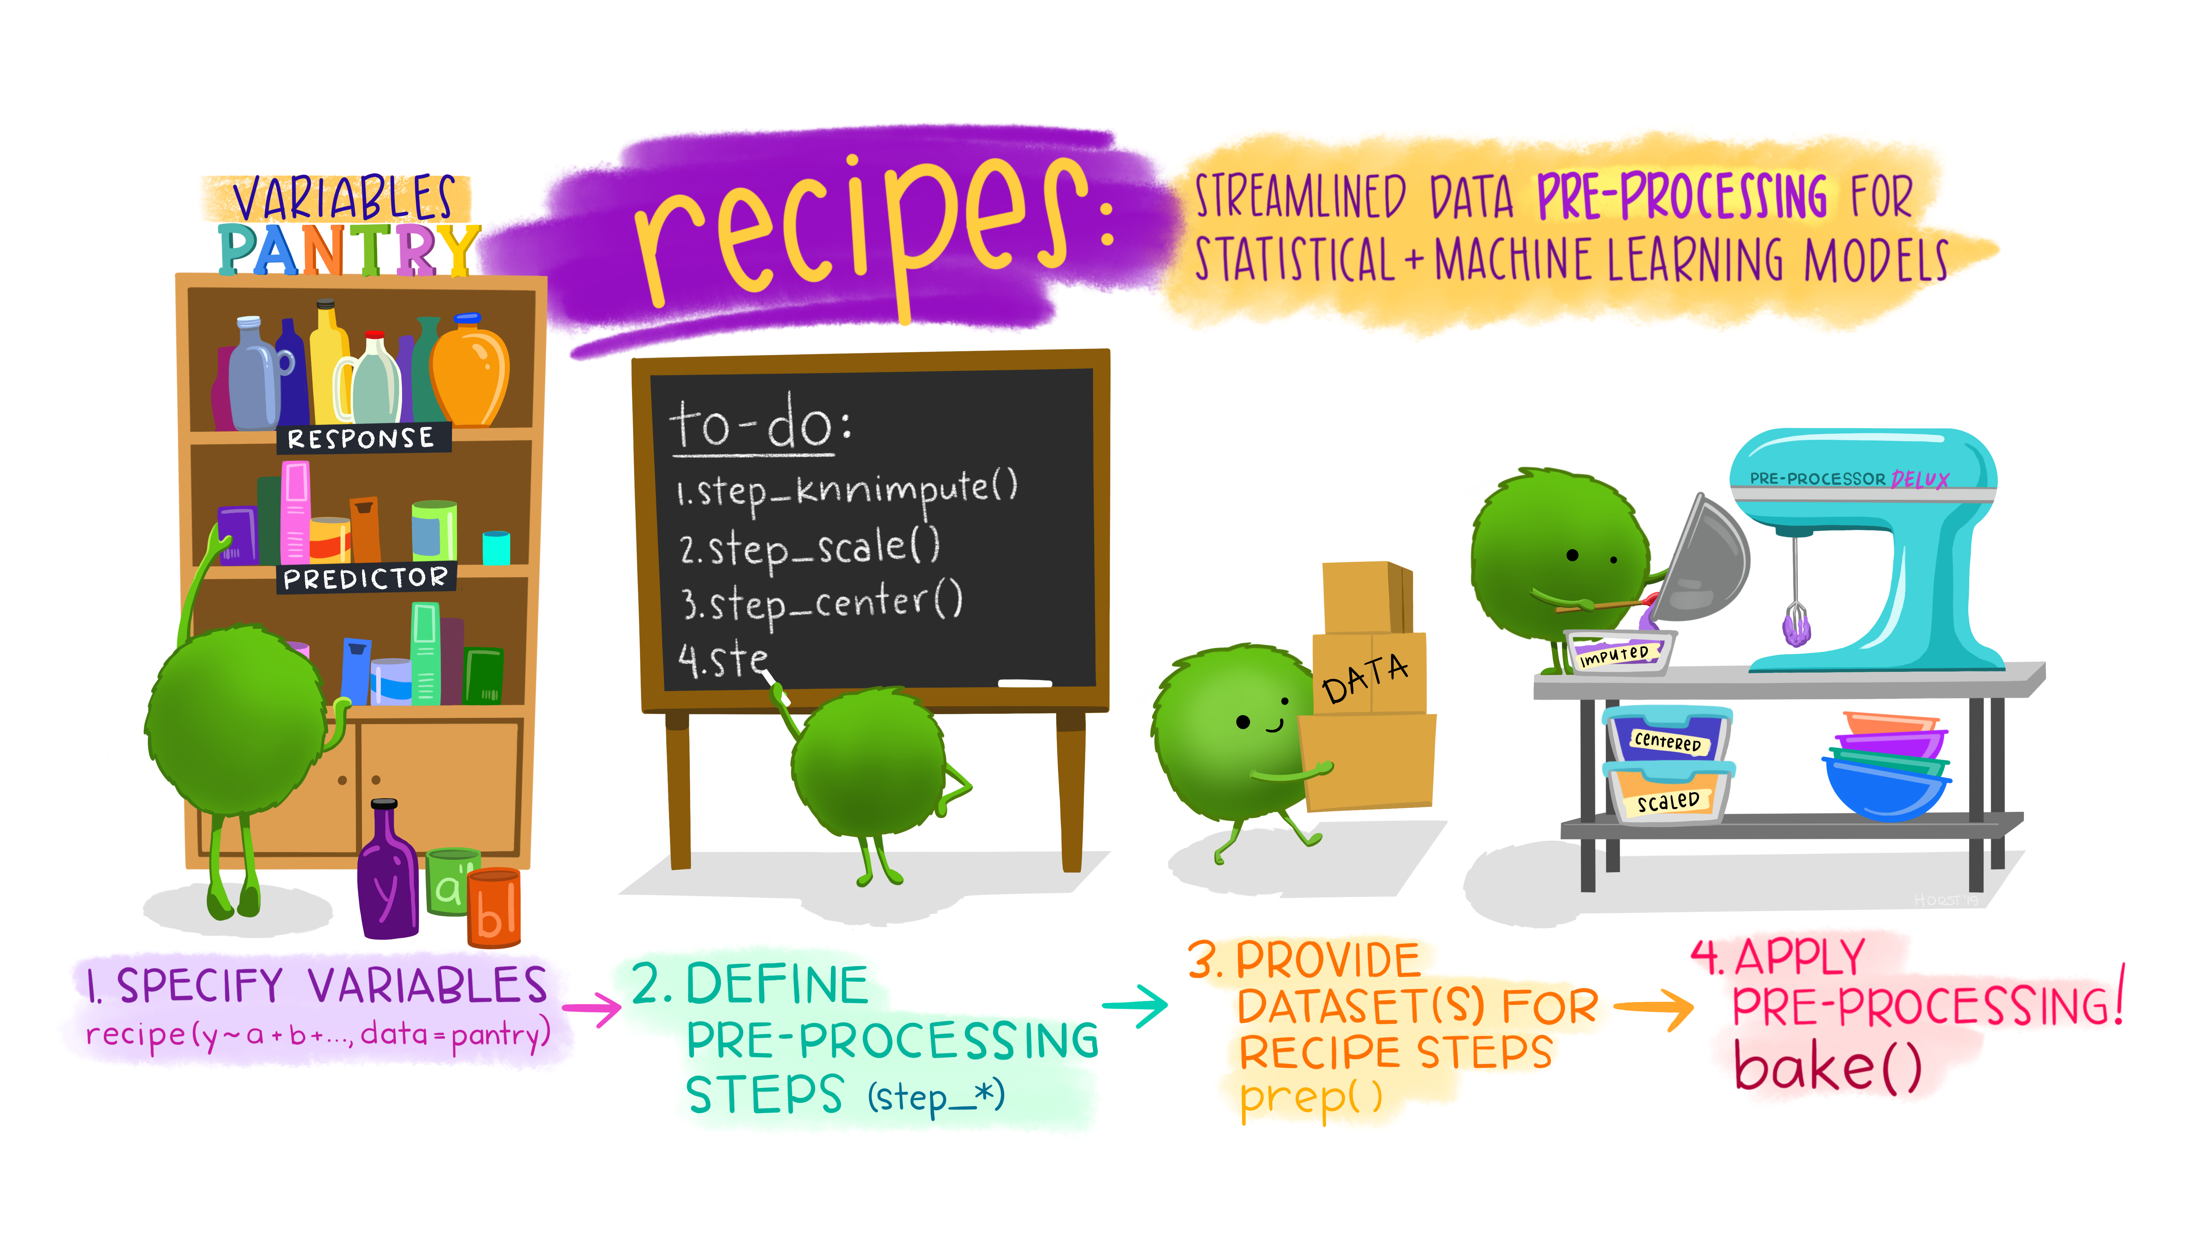
Prepare your data for modeling
Notes:
First you specify a dataset and variables.
Next you add preprocessing steps.
Then you prep the recipe to estimate the quantities for each step from the training data.
Finally, you can apply this prepped recipe to new data with bake.

Slide 27
recipe()
ames_rec <- recipe(Sale_Price ~ ., data = ames_train)
The recipe() function assigns columns to roles of “outcome” or “predictor” using the formula;

Slide 28
step_log()
ames_rec <- recipe(Sale_Price ~ ., data = ames_train)%>%
step_log(Sale_Price, base =10)
The step_log() log transforms our outcome, Sale_Price

Slide 29
step_other()
ames_rec <- recipe(Sale_Price ~ ., data = ames_train)%>%
step_log(Sale_Price, base =10)%>%
step_other(all_nominal(), threshold = 0.01)
when you have some factor levels with very few observations, all_nominal() selects both characters and factors, pools infrequently occurring values (frequency less than 0.01) into an "other" category;

Slide 30
step_nzv()
ames_rec <- recipe(Sale_Price ~ ., data = ames_train)%>%
step_log(Sale_Price, base =10)%>%
step_other(all_nominal(), threshold = 0.01) %>%
step_nzv(all_predictors())
all_predictors() remove predictors that are highly sparse and unbalanced;

Slide 31
step_center(), step_scale()
ames_rec <- recipe(Sale_Price ~ ., data = ames_train)%>%
step_log(Sale_Price, base =10)%>%
step_other(all_nominal(), threshold = 0.01) %>%
step_nzv(all_predictors()) %>%
step_center(all_numeric_predictors()) %>%
step_scale(all_numeric_predictors())
step_center() subtracts the column mean from numeric predictors;
step_scale() divides by the standard deviation.
Notes:
The recipe will use the training set to estimate the means and standard deviations of the data.

Slide 32
step_dummy()
ames_rec <- recipe(Sale_Price ~ ., data = ames_train)%>%
step_log(Sale_Price, base =10)%>%
step_other(all_nominal(), threshold = 0.01) %>%
step_nzv(all_predictors()) %>%
step_center(all_numeric_predictors()) %>% step_scale(all_numeric_predictors()) %>%
step_dummy(all_nominal_predictors(), one_hot = TRUE)
create numeric representations of categorical data…
AND MUCH MORE!

Slide 33
prep()
The prep() function takes a recipe and computes everything so that the pre-processing steps can be executed. Note that this is done with the training data.
ames_prep <- prep(ames_rec)
ames_prep

Slide 34
bake(), juice()
The bake() function takes a prepped recipe (one that has had all quantities estimated from training data) and applies it to new_data.
The juice() function is a nice little shortcut. When we juice() the recipe, we squeeze that training data back out, transformed in the ways we specified.
bake(ames_rec, new_data = ames_train)
juice(ames_rec)
Notes:
That new_data could be the training data again or it could be the testing data (with the TRAINING parameters);
Note that the juice() output is the same as bake(ames_rep, new_data = ames_train) and is just a shortcut that we are going to use later.

Slide 35
Notes:
First you specify a dataset and variables.
Next you add preprocessing steps.
Then you prep the recipe to estimate the quantities for each step from the training data.
Finally, you can apply this prepped recipe to new data with bake.

Slide 36
Your turn!
In this case study, you want to predict houses selling price from characteristics of these houses, like size and layout of the living space in the house. What kind of model will you build?

Slide 37
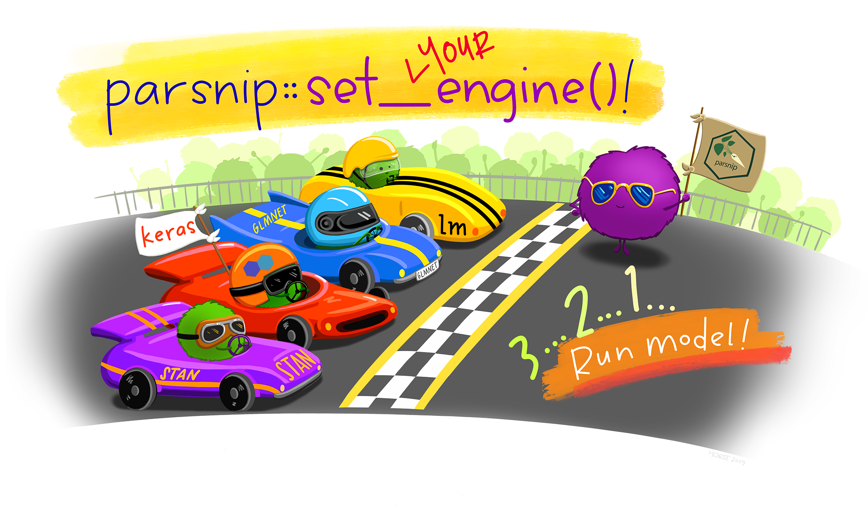
Build the model
ames_model <- linear_reg() %>% #pick a model
#set_mode("regression") %>%
set_engine("lm") #set the engine
All available models are listed at https://www.tidymodels.org/find/parsnip/
Notes:
We will specify the model using the parsnip package.
In tidymodels, you specify models using three concepts:
Type - differentiates models such as logistic regression, linear regression, and so forth;
Mode - includes common options like regression and classification, some model types support either of these while some only have one mode;
Engine - is the computational tool which will be used to fit the model.

Slide 38
fit()
Train the model
ames_fit <- ames_model() %>% #a parsnip model specifiaction
fit(Sale_Price ~ ., #a model formula
data = juice(ames_prep))#preprocessed training data
Notes:
The code trains our linear regression model on the prepped training data.
In our formula, we have specified that Sale_Price is the response variable and included all the rest as our predictor variables.

Slide 39
predict()
ames_test_baked <- bake(ames_prep, new_data = ames_test)
ames_test_results <-
predict(ames_fit, #a trained parsnip model object
new_data = ames_test_baked))
Notes:
Remember to bake your test data!
To assess the accuracy of our trained linear regression model, we must use it to make predictions on new data.

Slide 40
Metrics for model performance
Root Mean Square Error (RMSE): difference between the predicted (estimate) and observed values (truth) (loss of function);
R-squared (rsq): squared correlation between the predicted and observed values.
test_rmse <- rmse(ames_test_results,
truth = Sale_Price, #observed values
estimate = .pred) #predicted values
test_rsq<- rsq(ames_test_results,
truth = Sale_Price,
estimate = .pred)

Slide 41
Model
TRAINING DATA
How can we use the training data to compare and evaluate models?
fit()
recipe(), prep(), juice()
Trained Model
predict()
TESTING DATA
The testing data are precious!
recipe(), prep(), bake()
Predictions
Metrics
rmse()
rsq()
Notes:
Dangers of overfitting
What if we want to compare more models?
You just trained your model one time on the whole training set and then evaluated them on the testing set.
How can we use the training data to compare and evaluate different models?

Slide 42
Resampling – cross-validation
Fold 1
Fold 2
Fold 3
Fold 4
Fold 5
Fold 6
Fold 7
Fold 8
Fold 9
Fold 10
Notes:
If we use 10 folds, which percent of our data will end up in the training set and which percent in the testing set for each fold?

Slide 43
vfold_cv()
set.seed(9)
#10-fold cross-validation repeated 5 times
ames_folds <- vfold_cv(ames_train,
v=10,
repeats = 5,
strata = Sale_Price)

Slide 44
Your turn!
When you implement 10-fold cross-validation repeated 5 times, you:
randomly divide your training data into 50 subsets and train on 49 at a time (assessing on the other subset), iterating through all 50 subsets for assessment;
randomly divide your training data into 10 subsets and train on 9 at a time (assessing on the other subset), iterating through all 10 subsets for assessment. Then you repeat that process 5 times;
randomly divide your training data into 5 subsets and train on 4 at a time (assessing on the other subset), iterating through all 5 subsets. Then you repeat that process 10 times.

Slide 45
Let’s make our life easier!
Notes:
How do we fit our resamples now and evaluate our model?

Slide 46

workflow()
If you have a recipe and parsnip model, these can be combined into a workflow;
ames_wf <- workflow() %>%
add_model(ames_model) %>%
add_recipe(ames_rec)

Slide 47
fit_resample()
Once we have created a set of resamples, we can use the function fit_resamples() to fit a model to each resample and compute performance metrics for each;
ames_res <- ames_wf() %>%
fit_resamples(ames_folds,
control = control_resamples(save_pred = TRUE))
#Obtain performance metrics on resampled training data
ames_res %>% collect_metrics()

Slide 48
last_fit()
#Final fit on test dataset
ames_final <- ames_wf %>%
last_fit(ames_split)
#Access performance metrics
collect_metrics(ames_final)

Slide 49
Model
TRAINING DATA
fit_resamples()
recipe()
Trained Model
workflow()
last_fit()
TESTING DATA
Predictions
Metrics
collect_metrics()
Notes:
The recipe prepping and model fitting can be executed using a single call to fit() instead of prep()-juice()-fit();
The recipe baking and model predictions are handled with a single call to predict() instead of bake()-predict();

Slide 50




Your turn! Knowledge check- Match tasks to packages
Fit a linear model;
Prepare data for modeling;
Make a training/test split;
Bundle a recipe and model;
Compute R^{2;}
Create a resampling object.

